Slide 1
Meta - Social Media Analysis
Mohammad Atif
12/05/2025

Slide 2
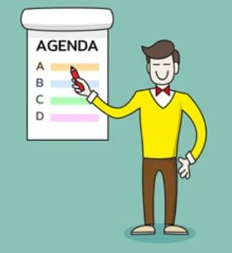
Agenda
Problem Statement
Data Description
Key Metrics and Visualizations
Insights and Recommendations

Slide 3
Project Statement: Analyzing Instagram user behavior to uncover patterns in engagement, content effectiveness, and user influence for strategic growth.
Objectives:
Understand what drives user activity and content success.
Identify potential influencers and brand ambassadors.
Provide actionable strategies for user re-engagement and targeted marketing.

Slide 4
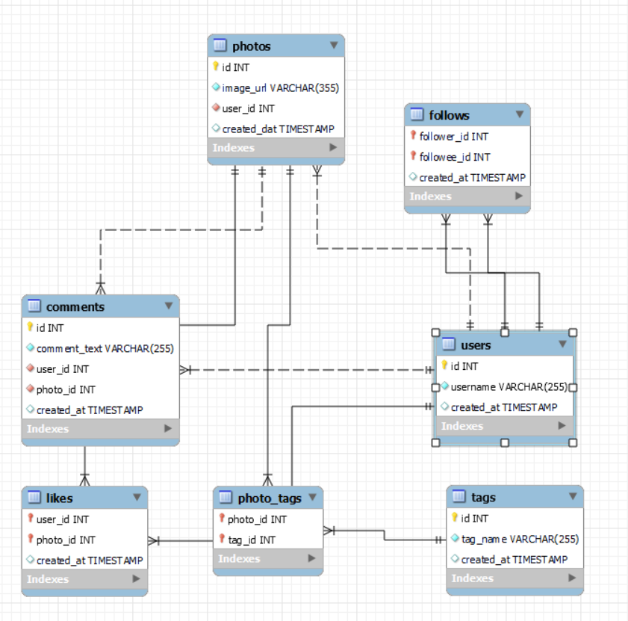
Database schema

Slide 5
Data description
comments_id : unique identifier for each comment
comment_text : text content of a given comment
user_id : unique identifier for each user
photo_id : unique identifier for each photo
created_at : date of interaction in the form like, photos, tags
follower_id : user_id of the follower for a certain user
followee_id : user_id of followee for a certain user
tag_id : unique identifier for each tag
image_url : link to the image posted on the platform
username : username chosen by the user
Data Link: Link

Slide 6
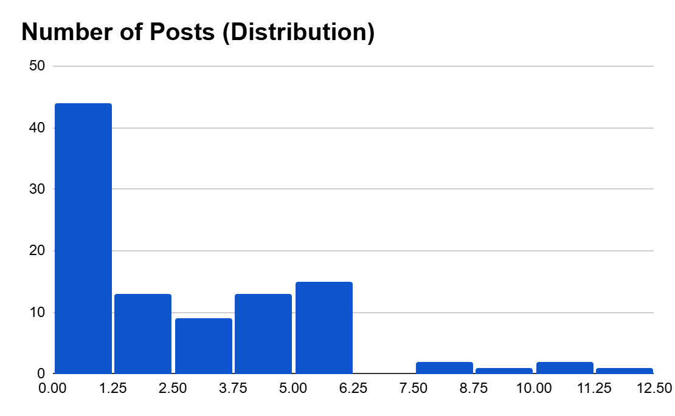
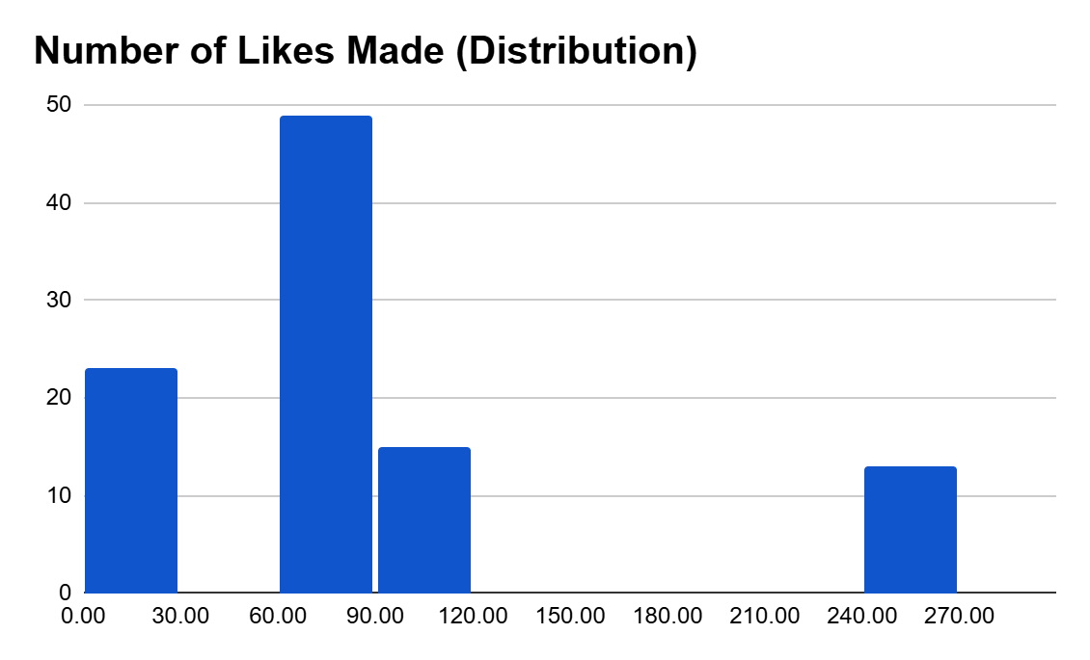
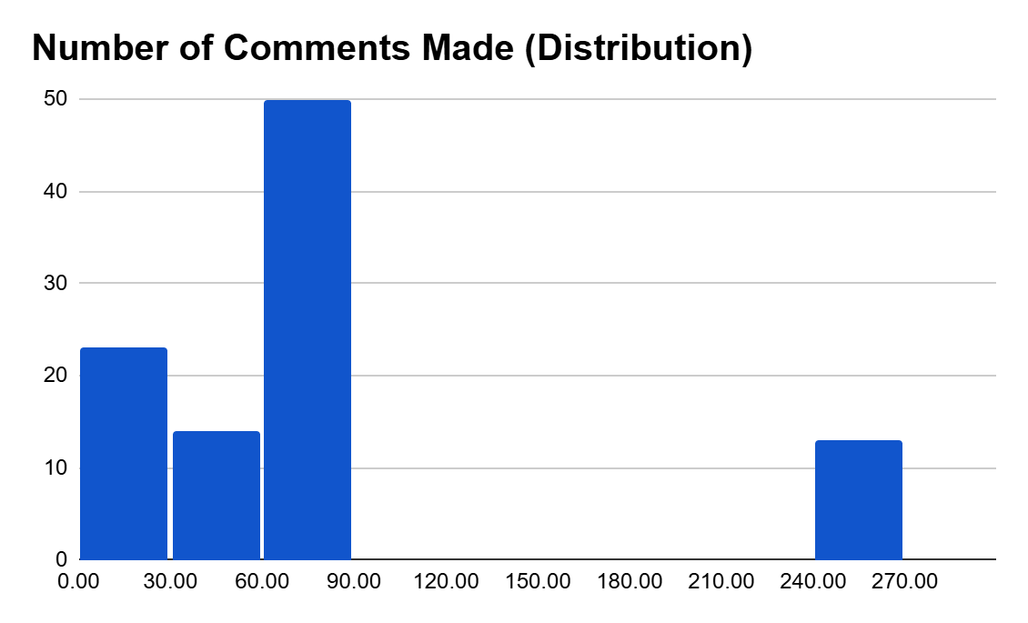
User Activity Distribution
Maximum No of users have never ever posted.
Most users have engagements (Likes or Comments)
There are some users who are completely inactive.

Slide 7
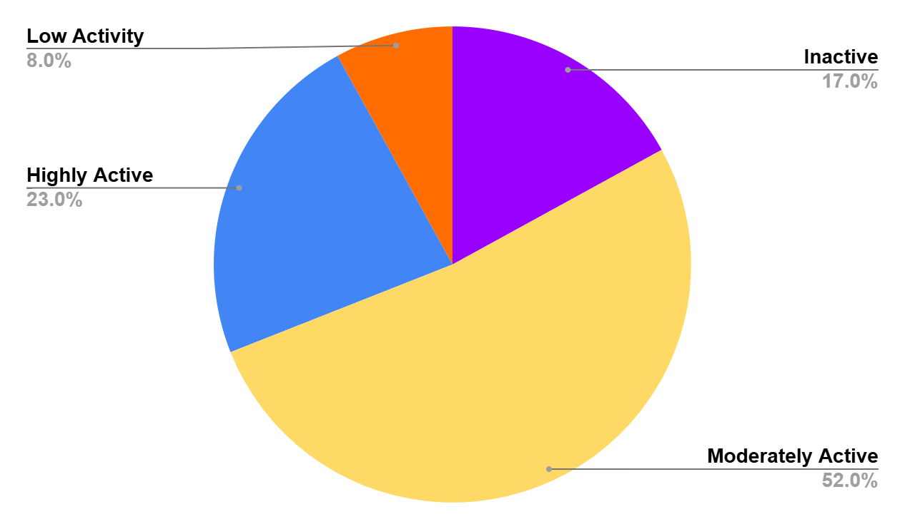
Users Segmentation
Highly Active – Regular posters and frequent engagements.
Moderately Active – Some posts and moderate engagement.
Low Activity – Rarely posts or engages.
Inactive – No likes or comments.

Slide 8
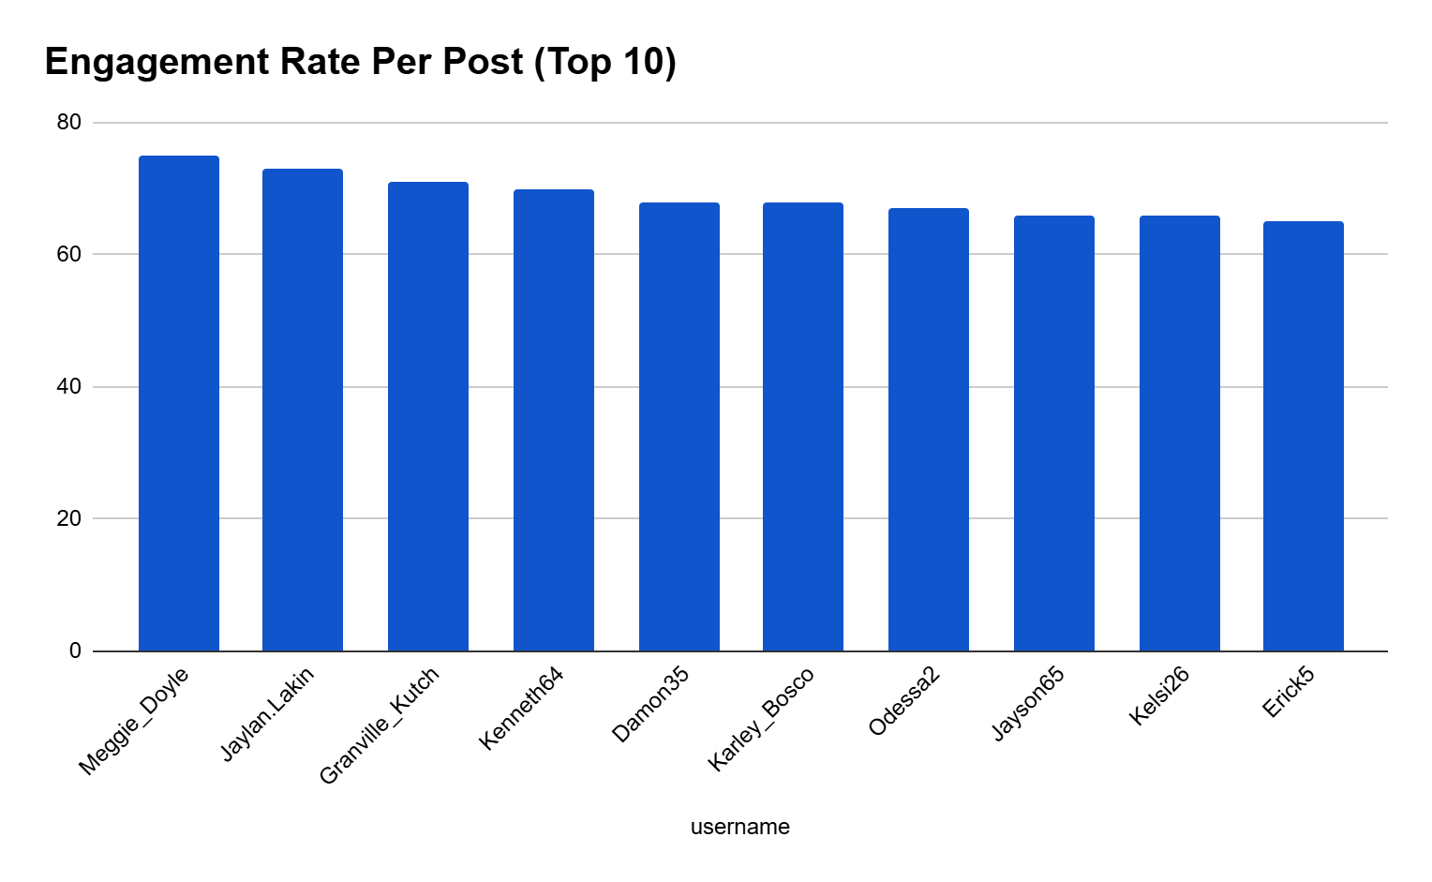
Top Users !!
Most Followed Users
Kenton_Kirlin
Kasandra_Homenick
Eveline95
Tierra.Trantow
Jaime53
Pearl7
David.Osinski47
Morgan.Kassulke
Mariano_Koch3
Linnea59
Aurelie71
Cesar93
Florence99
Franco_Keebler64
Hulda.Macejkovic
Donald.Fritsch
Darby_Herzog
Esther.Zulauf61
Bartholome.Bernhard
Delfina_VonRueden68
Clint27
Jessyca_West
Esmeralda.Mraz57
Meggie_Doyle has the Highest Engagement rate
All the users mentioned in the list have same amount of followers = 77

Slide 9
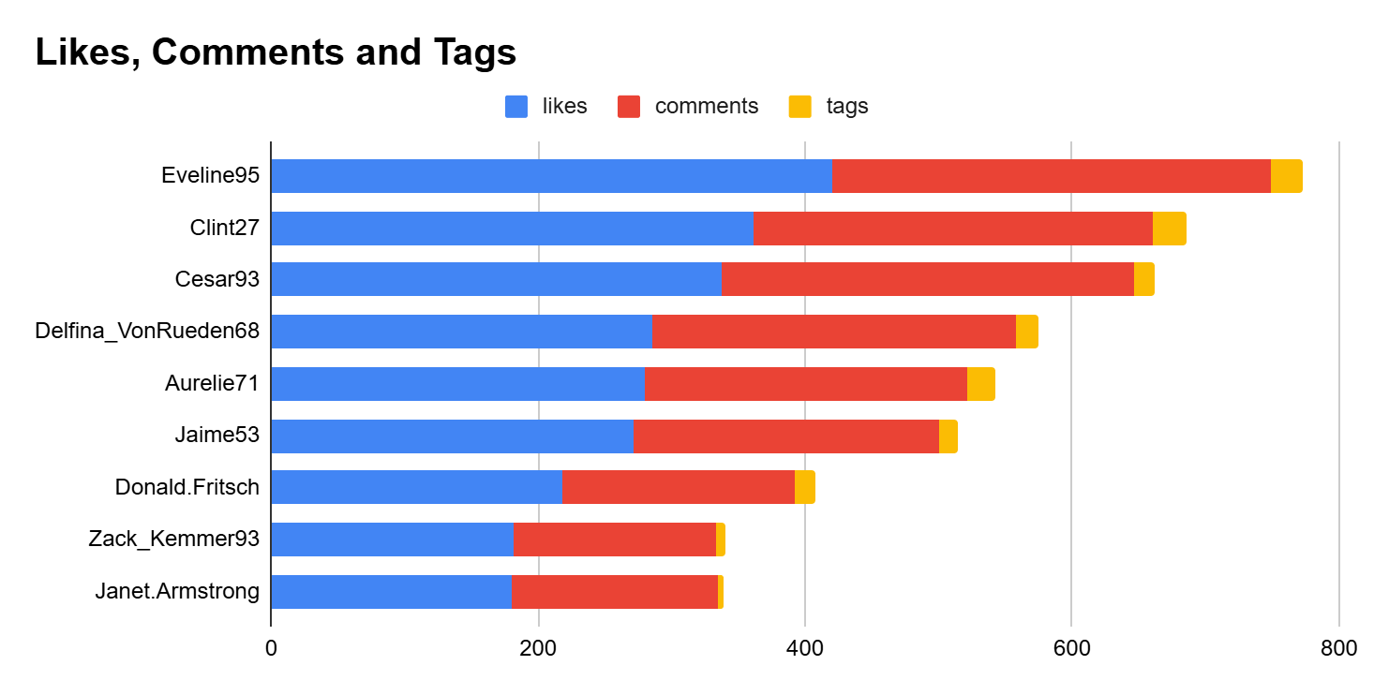
Users Receiving Most Likes, Comments and Tags
Eveline95 received the most amount of users engagements = 761

Slide 10
Selected Potential Influencers for Marketing Campaign Based On Analysis
User Name | Total Followers | Total Posts | Engagement Rate per Post
Donald.Fritsch | 77 | 6 | 65.3333
Aurelie71 | 77 | 8 | 65.25
Cesar93 | 77 | 10 | 64.6
Florence99 | 77 | 5 | 64
Jaime53 | 77 | 8 | 62.5
Eveline95 | 77 | 12 | 62.4167
Users with both high follower counts and strong engagement are prioritized.
The final result ranks the top 6 most influential users for marketing outreach.

Slide 11
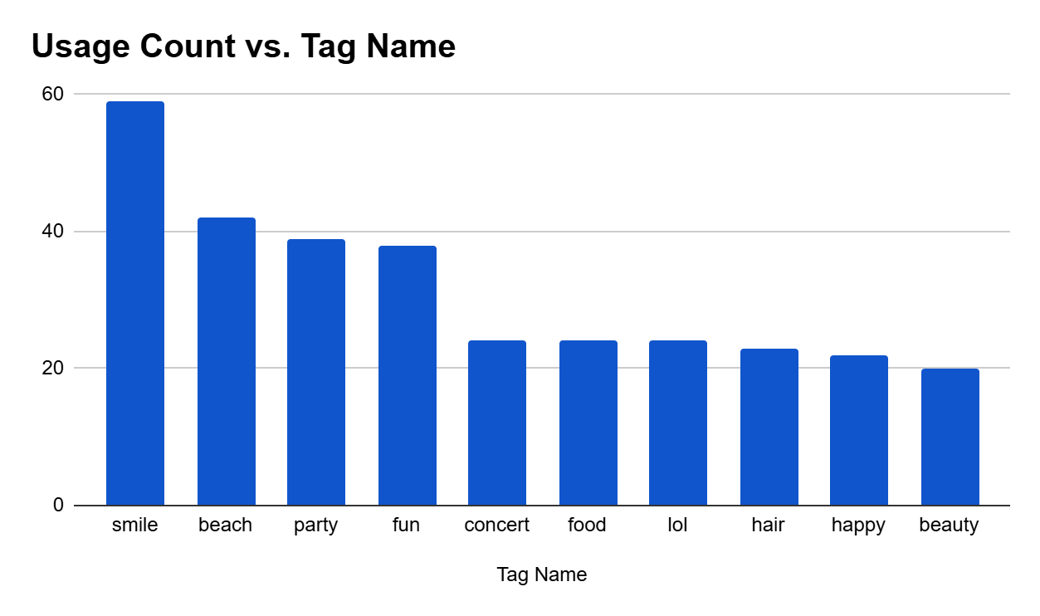
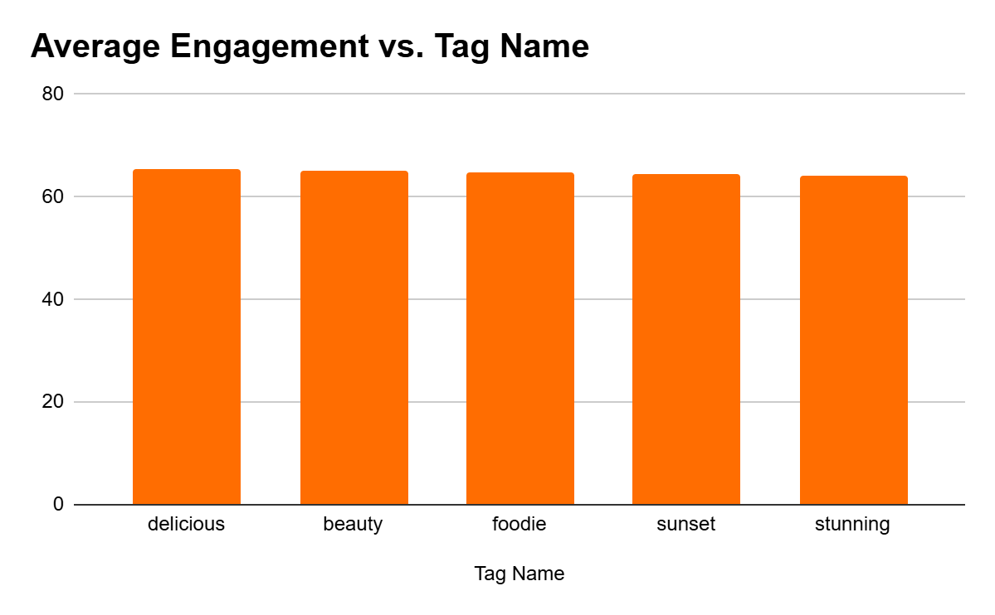
Leveraging User Generated Contents
User-generated content such as posts, hashtags, and photo tags reveals users' interests and preferences.
By analyzing frequently used tags, we can segment audiences and personalize ad campaigns based on trending topics.
This insight helps shape a content strategy by encouraging creators and marketers to use top-performing hashtags and create content around those themes.
It also enables targeted ad campaigns by aligning product promotions with users’ current interests

Slide 12
Inactive Users !!
User Name | Total Likes | Total Comments | Total Posts
Kasandra_Homenick | 0 | 0 | 0
Tierra.Trantow | 0 | 0 | 0
Pearl7 | 0 | 0 | 0
David.Osinski47 | 0 | 0 | 0
Morgan.Kassulke | 0 | 0 | 0
Linnea59 | 0 | 0 | 0
Franco_Keebler64 | 0 | 0 | 0
Hulda.Macejkovic | 0 | 0 | 0
Darby_Herzog | 0 | 0 | 0
Esther.Zulauf61 | 0 | 0 | 0
Bartholome.Bernhard | 0 | 0 | 0
Jessyca_West | 0 | 0 | 0
Esmeralda.Mraz57 | 0 | 0 | 0
The above is list of users who have never posted or made any like or any comment
To re_engage these users, I have made few suggestions in the coming slides

Slide 13
Marketing Strategies - User Acquisition (for Active Users)
Identifying Loyal and Valuable Users and Rewarding them
The most loyal or valuable users can be identified by analyzing high and consistent engagement metrics.
These users actively contribute to the platform’s ecosystem and drive network effects.
They can be rewarded through :
exclusive badges, priority support, early feature access, or spotlight opportunities
(e.g., “Top Creator of the Month”).
Eveline95
Clint27
Cesar93
Delfina_VonRueden68
Aurelie71
Jaime53
Donald.Fritsch
Janet.Armstrong
Zack_Kemmer93
Alexandro35

Slide 14
Marketing Strategies - User Retention !! (for Inactive Users)
Kasandra_Homenick
Tierra.Trantow
Pearl7
David.Osinski47
Morgan.Kassulke
Linnea59
Franco_Keebler64
Hulda.Macejkovic
Darby_Herzog
Esther.Zulauf61
Bartholome.Bernhard
Jessyca_West
Esmeralda.Mraz57
To re-engage inactive users, first identify them through low activity metrics.
Then, implement personalized re-engagement campaigns such as email/app notifications with content suggestions based on their past interests.
Use incentives like rewards, badges, or follower boosts for first re-engagement actions.
Introduce “catch-up” features and AI-driven post ideas or templates to lower the friction for content creation.
Offering exclusive events, discounts, or creator tools can further pull them back in.

Slide 15
Marketing Strategies - Personalized Recommendations
Eg:
For User_id = 11
Tag Name | Tag Count
fun | 2
food | 2
foodie | 2
delicious | 2
lol | 1
happy | 1
concert | 1
smile | 1
User-generated content such as posts, hashtags, and photo tags reveals users' interests and preferences.
By analyzing frequently used tags, we can segment audiences and personalize ad campaigns based on trending topics.
To run targeted ads, we analyze users' most frequently used tags from their posts.
Similarly, We can run ads with relatable content for all the users !!

Slide 16
CONCLUSIONS - Key Findings
User Engagement is Uneven: A significant portion of users are either inactive or show minimal interaction despite having content.
Highly Active Users (Top ~10%) drive the platform’s energy and deserve retention and recognition efforts.
Moderately & Low Activity Users show potential for growth if nudged with the right content and campaigns.
A large Inactive User Base represents untapped potential — needs re-engagement strategies.

Slide 17
CONCLUSIONS - Strategy
Reward & Retain highly active users with recognition, features, and gamified incentives.
Nurture Growth among moderate and low activity users through personalized engagement nudges and content suggestions.
Reignite Inactive Users using tailored reactivation emails, surveys, and simplified onboarding flows.
Implement Metrics like Engagement Score and Retention Cohorts to track effectiveness of future strategies.

Slide 18


